Slide 1
Public education for children and youth experiencing homelessness
Sandy Schmidt
Mckinney vento liaison + foster care point of contact
Bend laPine school district
Notes:
Thank you so much for the opportunity to speak with you today about my role as the MKV Liaison with Bend La Pine Schools. I will go over the McKinney Vento Act – what it is and what my roles are. Then I will give you some data regarding our current population at Bend La Pine and talk a little about our families in Deschutes County.

Slide 2
“hidden homeless”
We don’t see children, youth, and families in the same way that we see adults who experience homelessness. Most children and youth experiencing homelessness are not visible in shelters or on the streets, but rather moving from place to place - couches, motels, cars, and wherever they can find temporary shelter.
Notes:
This makes it difficult to identify and support families. There is a lot of shame, parents feel they are not “good parents” so do not want to disclose
There is fear that child welfare will take their children – the fact that poverty is not abuse or neglect needs to be reinforced.
HUD definition not including “doubled up” and families who pay for their own motel rooms contributes this undercounting in PIT Count

Slide 3
Mckinney vento act
Under the McKinney Vento (MKV) Act, State educational agencies must ensure that each houseless child and youth has equal access to the same free, appropriate public education, including a public preschool education, as other children and youths.
Designed to address the challenges that children and youth experiencing homelessness face in enrolling, attending, and succeeding in school
MKV eligibility lasts through the school year in which they are found to be eligible
Notes:
Originally authorized in 1987 and most recently re-authorized in December 2015 by the Every Student Succeeds Act (ESSA)
Every school district in every state has one of me!
Difficult to attend school and do homework when you are experiencing housing instability.
MKV eligibility is redetermined each school year

Slide 4
Definition of homelessness under mckinney vento
MKV definition differs from the department of housing and urban development’s definition

Slide 5
Individuals who lack a fixed, regular and adequate nighttime residence
The term includes children and youths who are:
Sharing the housing of other persons due to loss of housing, economic hardship or a similar reason (referred to as “doubled up”)
Living in motels, hotels, trailer parks, or camping grounds due to the lack of alternative adequate accommodations
Living in emergency or transitional shelters
Living in a primary nighttime residence that is not ordinarily used as regular sleeping accommodations (cars, parks, public spaces, etc.) or is substandard (lacking utilities, overcrowded, unsafe, etc.)
Notes:
Doubled up does not align with HUD’s definition. Advocacy happening on a national level to change this. Our most unstable homes, no legal rights as in case of house fire where everything was lost, and these situations can go sideways quickly due to often overcrowded conditions at the homes.
Motels/Hotels also does not align with HUD unless it’s being paid for by an agency. We are seeing more families living long term in motels, difficult cycle to get out of due to the cost, more expensive to eat due to lack of full kitchens and refrigerators.
Substandard can be doubled up, youth and families in sheds, garages, inadequate space

Slide 6
Unaccompanied Children and youth
The MKV Act has provisions for students who are not in the physical custody of a parent or legal guardian and who lack a fixed, regular, or adequate nighttime residence.
Most of our unaccompanied children and youth experienced instability in their homes
Can be any age but are predominantly high school students
Are among our most vulnerable students but unlikely to seek services
Face barriers to accessing program supports due to age restrictions
Under MKV, paperwork cannot be a barrier to receiving an education
Notes:
Won’t self disclose due to fear of child welfare or cannot access services on their own due to age restrictions
National research: 30% of unaccompanied homeless youth were sexually abused in their homes, 50% were abused physically and an estimated 1/3 of UHY identify as LGBTQ+
Homelessness is associated with an 87% likelihood of dropping out of school
Unaccompanied homeless youth consistently report family dysfunction as a primary reason they no longer live at home. Family problems often include issues related to parental substance abuse, pregnancy and sexual activity or orientation. In addition, parental neglect and abuse (emotional, physical or sexual), incarceration, illness, deportation or death can lead to youth being on their own. Many youth experience homelessness after running away from a foster care placement or aging out of foster care.

Slide 7
Role of the mckinney vento liaison
To protect the educational rights of children and youth experiencing houselessness.
Notes:
In OR, MKV Liaison also acts as the Foster Care Point of Contact as the roles align – assisting with enrollment and transportation

Slide 8
Mkv Liaison responsibilities
Identifying MKV eligible children and youth
Enrolling students immediately in the school of origin or school of residence even if they are unable to produce academic and immunization records, proof of address or other documentation typically required for enrollment
Enrolling students in the Free and Reduced Lunch program – application waived
Ensuring student’s IEP evaluations are expedited
Connecting families and students to basic need resources and FAN Advocates
Providing FAFSA Verification of Independence Letters for unaccompanied youth experiencing homelessness
Notes:
Identifying includes training staff and community partners on the MKV program and eligibility, outreach
Difficult to have documents when you are highly mobile – parent who fled DV situation in Salem, family who had trailer broken into when camped, family who couldn’t maintain the cost of their storage unit after they lost their apartment when they could no longer afford the rent

Slide 9
Mkv Liaison responsibilities continued
Arranging transportation to ensure that students can attend their school of origin for the remainder of the academic school year
School of origin: the school that a child or youth attended when permanently housed or the school in which the child or youth was last enrolled
Students lose educational ground with each significant school change
High mobility resulting in a lack of continuity and increased absenteeism
Loss of adult and peer relationships and difficulties feeling connected at school
Notes:
Transportation is a large piece of what I do – school of origin vs school of residence, students lose educational ground with each signification school change, anxiety about changing, relationships lost with adults and peers
Parents who experienced homelessness as a child will share that they attended 10, 11, 15 different schools while growing up
family at BI, chronic homelessness/SPED, Stepping Stones to Healy Heights - student made great strides at NSE
need to be able to access students and cannot drive bus down dirt, unimproved roads

Slide 10
Mckinney vento at Bend lapine

Slide 12
2023-24 MKV Data for Bend La Pine
Level | Totals | PK | KG | 1 | 2 | 3 | 4 | 5 | 6 | 7 | 8 | 9 | 10 | 11 | 12 | TC
ELEM | 259 | 14 | 37 | 39 | 30 | 47 | 52 | 40
MS | 106 |  |  |  |  |  |  |  | 38 | 36 | 32
HS | 178 |  |  |  |  |  |  |  |  |  |  | 43 | 48 | 36 | 51
District Totals | 543 | 14 | 37 | 39 | 30 | 47 | 52 | 40 | 38 | 36 | 32 | 43 | 48 | 36 | 51 | 0
Qualifying Factor
Doubled Up | 330 | 61%
Unsheltered | 95 | 18%
Shelter/Transitional Housing | 81 | 15%
Hotel/Motel | 37 | 7%
Total Qualifying Factor | 543
Total UHY | 119
UHY Seniors/FAFSA Letters | 41
MKV Family Count | 375
Total 0-5 year olds | 81

Slide 13
Attendance + graduation data
School Year | Non-MKV Attendance Rate | MKV Attendance Rate | Non-MKV Chronically Absent Rate | MKV Chronically Absent Rate
2022-2023 | 89.1% | 80.4% | 41.2% | 69.2%
2022-23 Graduation Rate:
84% for all BLP students; 69% for our MKV eligible students
Notes:
Chronic Absenteeism = not attending school for 10 percent or more of school days that the student is enrolled.

Slide 14
Education changes lives
Youth without a high school diploma/GED are 4.5 times more likely to experience homelessness later in life.
Notes:
This makes the lack of a high school diploma/GED the single greatest risk factor for future homelessness. (https://schoolhouseconnection.org/article/the-education-of-children-and-youth-experiencing-homelessness-current-trends-challenges-and-needs)

Slide 15
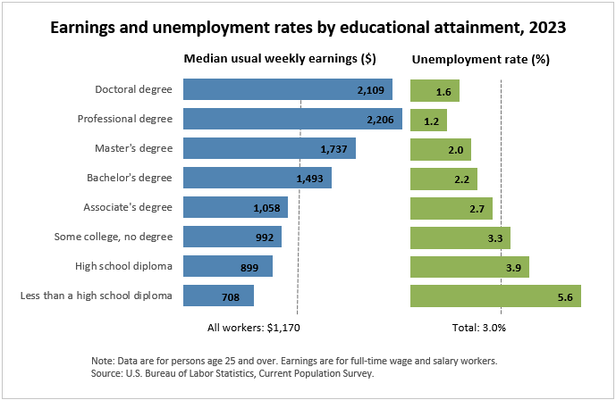

Slide 16
Education can help break the cycle of homelessness
Public schools are the single largest provider of services to children and youth experiencing homelessness.
Schools provide safety, stability, and access to food, health and mental health services, and caring, supportive adults along with peer socialization.
Schools are uniquely able to identify and respond to children, youth, and families experiencing homelessness.

Slide 17
Who are our families?
Not all the families we work with are living in poverty.

Slide 18
Alice - asset limited, income constrained, employed
Households that earn more than the Federal Poverty Level, but less than the basic cost of living for the county
For a family of 4 in 2022 in Deschutes County: FPL $27,750 vs. ALICE $81,180
Households below the ALICE Threshold — ALICE households plus those in poverty — can’t afford the essentials
Housing, utilities, childcare, food, transportation, health care, basic smart phone plan and taxes
26% of all households in Deschutes County live below the ALICE threshold
77% of single female headed households with children; 50% of single male headed households with children; 45% of 25-year-old and under households
Major life events like loss of a job, health crisis and divorce can cause an ALICE household to tumble into poverty
Notes:
9% of households are living in poverty
ALICE families working 1, 2, 3 jobs to survive

Slide 19
Questions or comments?
Thank you so much for your time and interest

